Slide 1

Smart Agriculture System Based on IoT
By N.V.S. ADITYA
MENTOR: Mr. Durga Prasad
Smart Bridge Internship

Slide 2
Technologies Used
Watson IoT Platform
Node-red
IBM Cloud
Weather Info API
Web App
Python 3.8

Slide 3
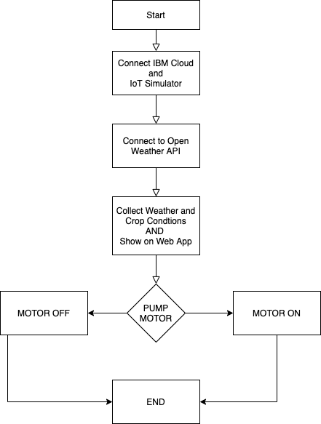
Flow Chart

Slide 4
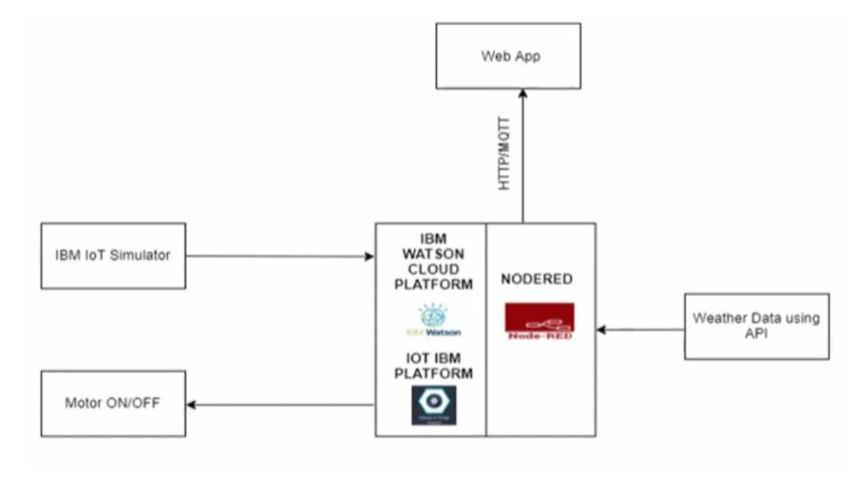
Block Diagram

Slide 5
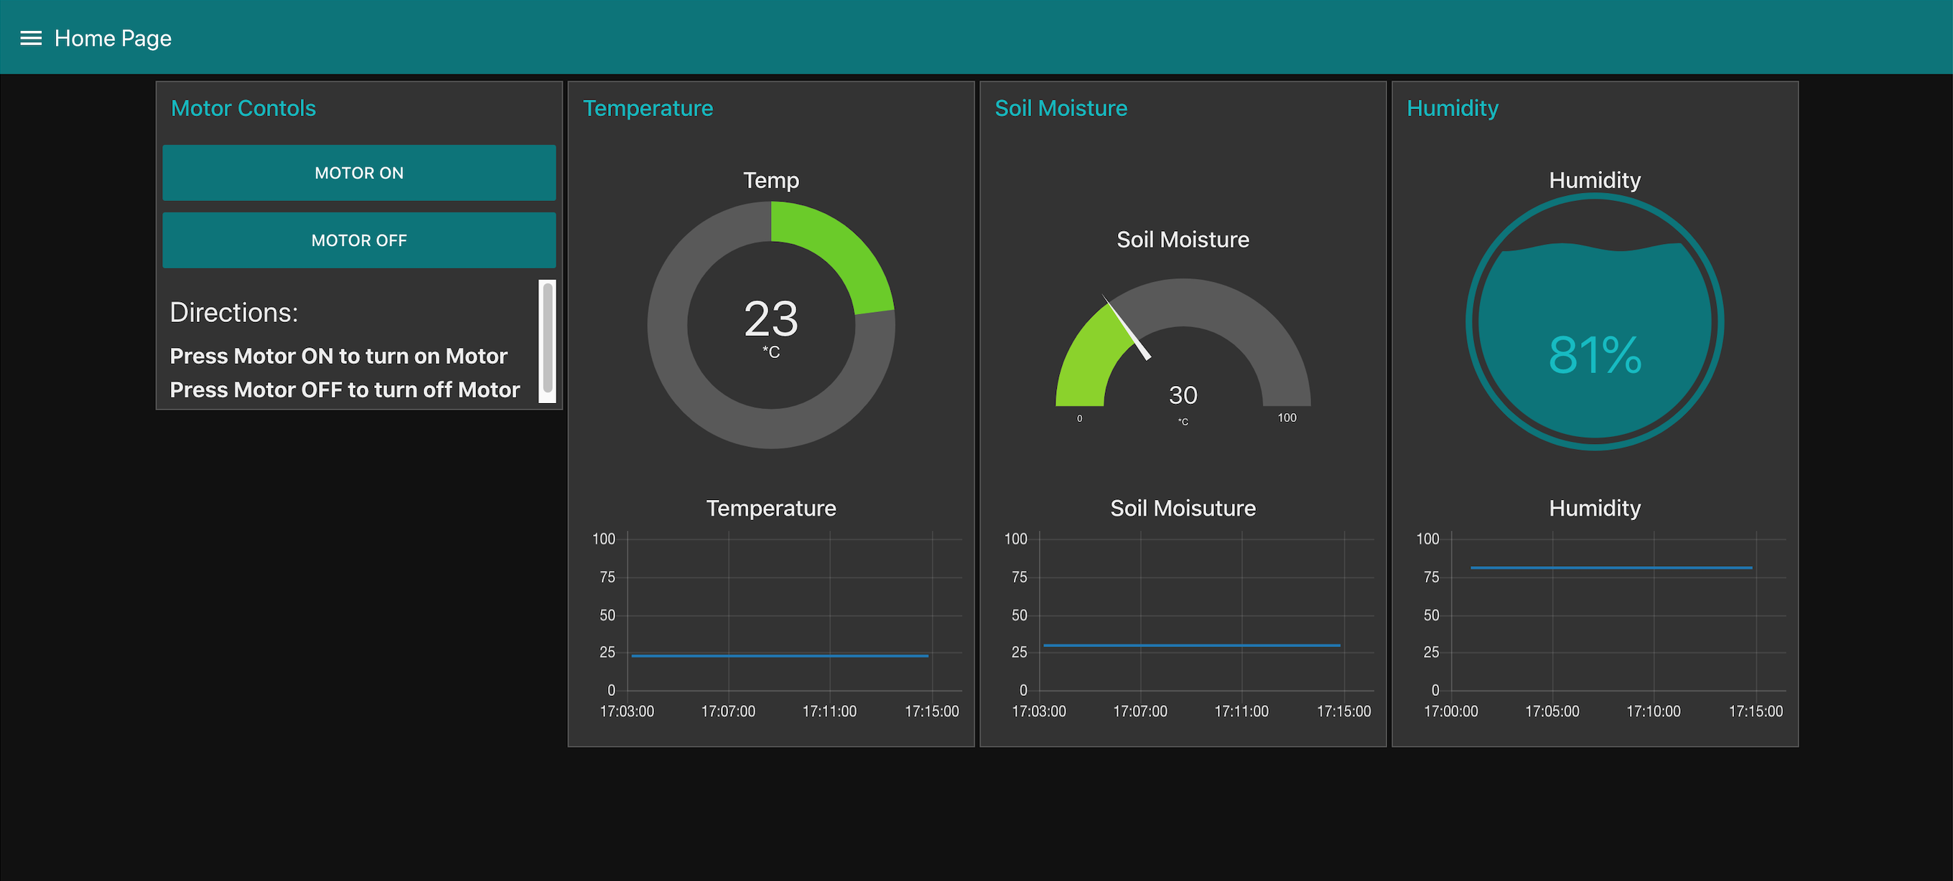
Dashboard

Slide 6
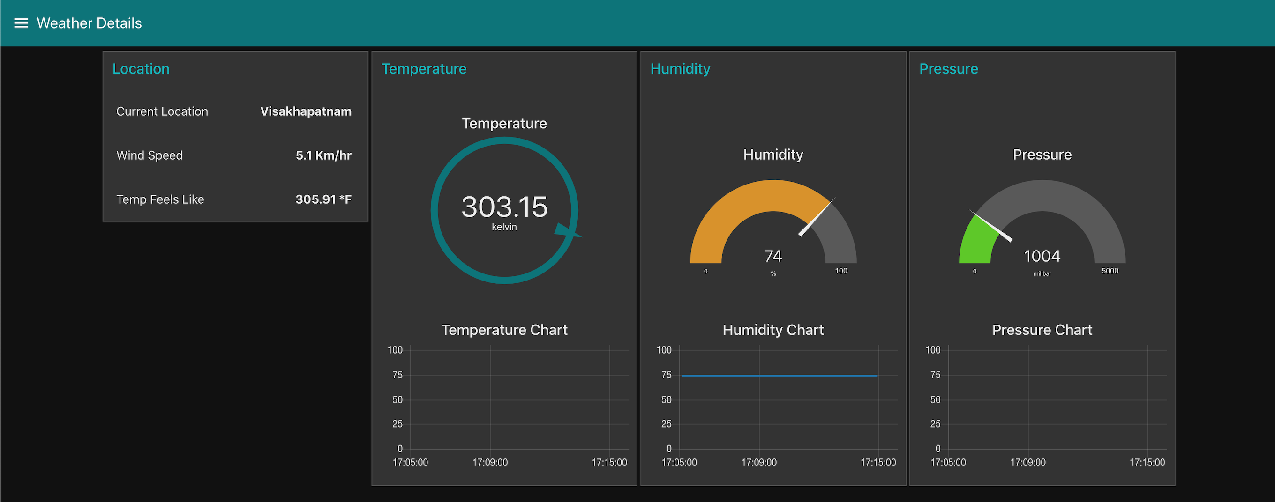
Weather Info

Slide 7
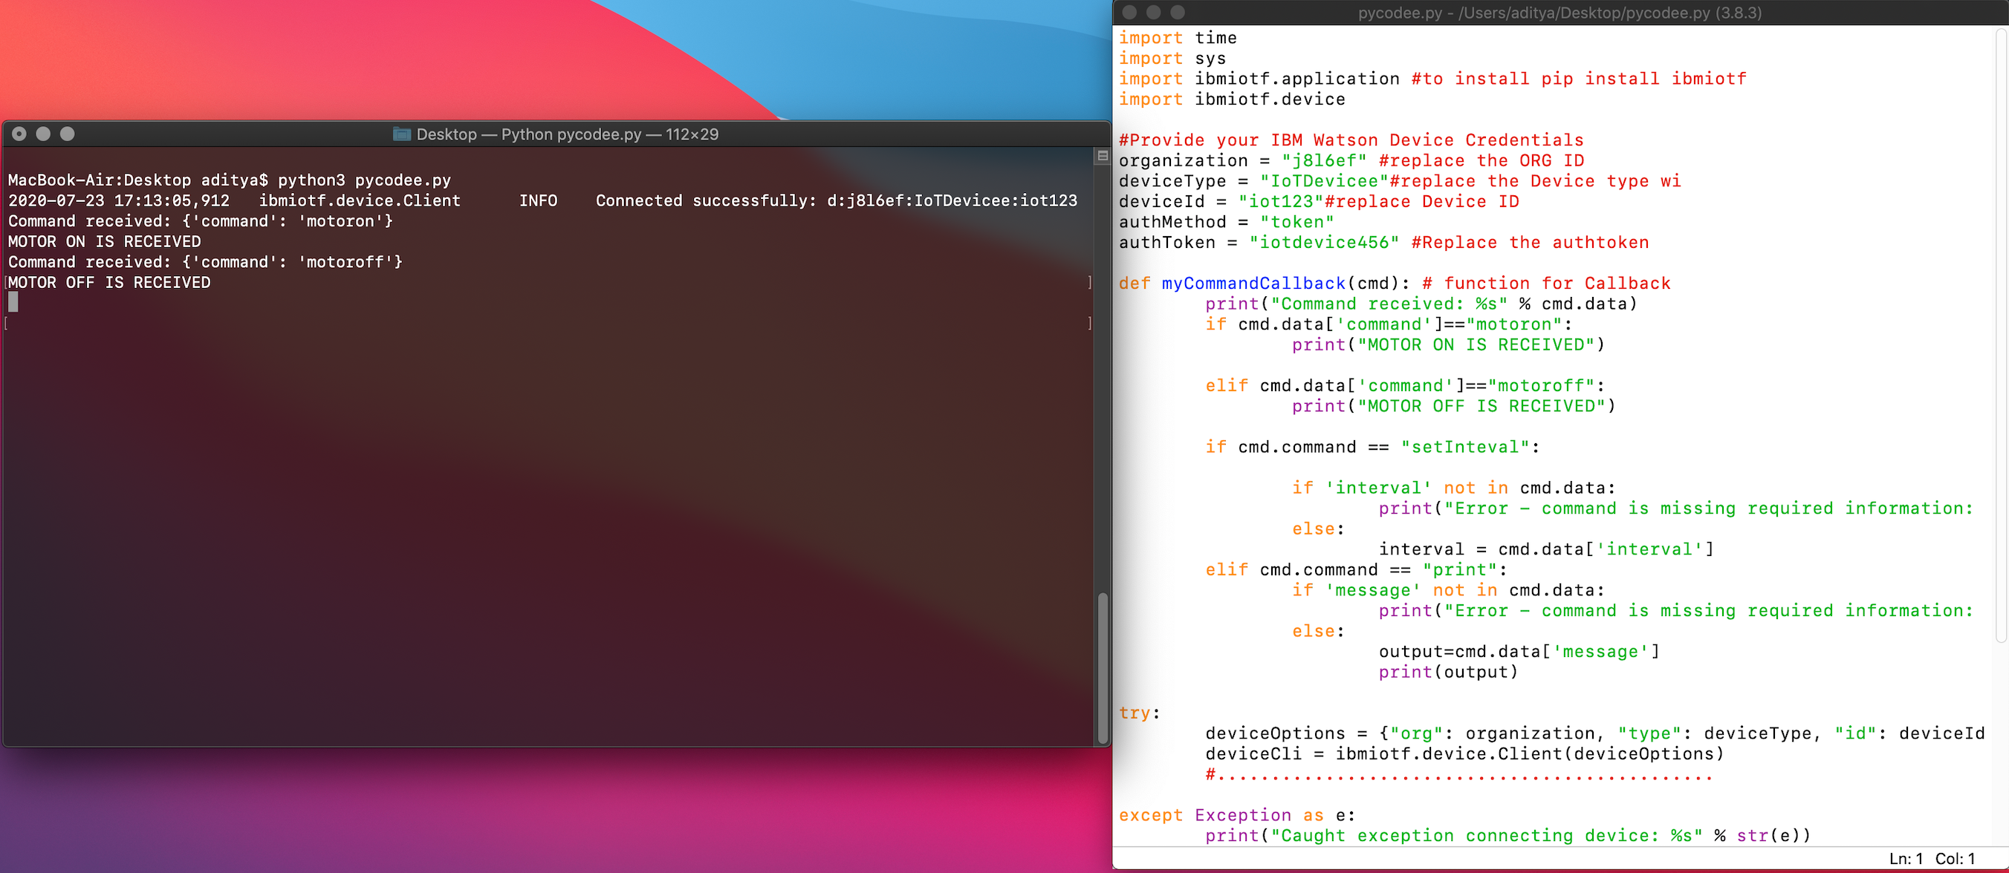
Python Script

Slide 8
Thank you

